Slide 1
QUALNET Quick start
2021-09-30

Slide 2
Overview
Foreword
First connection / how to change password
FAQ
3
4
5-6

Slide 3
Foreword
ITO-PM
URL adresses :
Recommended browser : Chrome
Environnement | URL
QUAL | https://rct-iqd.caceis.group.gca/iqd/portail_qual/
PRE-PROD | https://preprod.olisnet.com/iqd/portail_pprd/
PROD | https://olisnet.com/iqd/intraqual_prd/

Slide 4
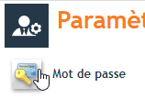
First connection / how to change password
On top of home page, click on the ‘Fiche utilisateur’ (image shows 2 silhouettes) (if you don’t see this button, refresh page, or click on ‘workflow’ tab) |  | En haut de l’écran d’accueil, cliquer sur l’icône ‘Fiche utilisateur’ qui représente 2 personnes (si ce bouton ne s’affiche pas en quelques secondes, rafraichir ou faire ‘workflows’
Then, on top of ‘Paramètre utilisateur’ screen , under the header, click on ‘Mot de passe’ Then record the new password |  | Puis, en haut de l’écran ‘Paramètre utilisateurs’, sous le titre, choisir ‘Mot de passe’. Enfin, enregistrer le nouveau mot de passe.

Slide 5
FAQ
How should I create a new ticket ?
On the top banner, use the « nouvelle fiche » button
If you dont have button, this is link to your rights. Contact admin to ask for more rights.

Slide 6
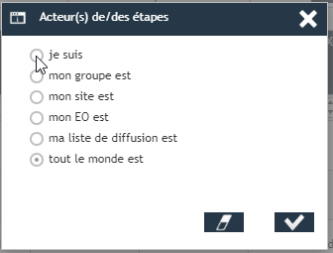
FAQ
Where is my ticket ?
Default dashboard only shows tickets where your actions are required. If you want to follow-up tickets you have several solutions
To search for one ticket, use the search field on top right
On advance search page, filter on fields or on actor

Slide 7
FAQ
Where is my ticket ?
Default dashboard only shows tickets where your actions are required. If you want to follow-up tickets you have several solutions
To search for one ticket, use the search field on top right
On advance search page, filter on fields or on actor
Note that you need to select a workflow first, then search you ticket. Transversal searches are not possible.

Slide 8
An other question ?
Réunion d’équipe PCM
This document is focussed on transversale question about Qualnet.
For PCM workflow, you’ll find another FAQ, with specific question
If you can’t find the appropriate answer, please share your question to :
Alexandra Peudon
Fabrice Martin
Jonathan TUAL

